Slide 1


Oracle PL/SQL unit testing with ruby-plsql-spec
Yavor Nikolov
Nov 20, 2015, Pravets

Slide 2
Do you test your database code?
How?

Slide 3
Why?

Slide 4
What is a legacy system?
You spot an obvious design problem
know how to improve that,
but the thought about consequences gives you a stomach ache
source: Gojko Adzic, "Fighting the monster"

Slide 5
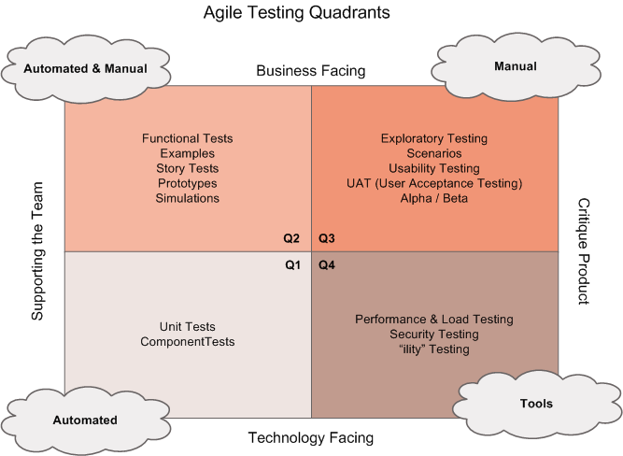
source: http://lisacrispin.com/2011/11/08/using-the-agile-testing-quadrants

Slide 6
Challenges of PL/SQL testing
Inherently hard to test. Isolation is difficult
Changes are persistent
Shared environment
Triggers, Constraints, Dependencies
Tools
PL/SQL based: too much boilerplate code
GUI-based: too limited and time-consuming to maintain
Attitude ("it's not my job")

Slide 7
Why (automated) testing?
Safety net - provides confidence/removes fear
Documentation
Early feedback - detect problems when it’s easy to fix them
Saves time, helps focusing on solving the main problem
Enables techniques for better design (TDD)
Makes application change easier

Slide 8
Anatomy of a unit test
Arrange (set up the context)
Act (exercise the system under test)
Assert (verify results)
Tear Down (to isolate other tests from this one)

Slide 9
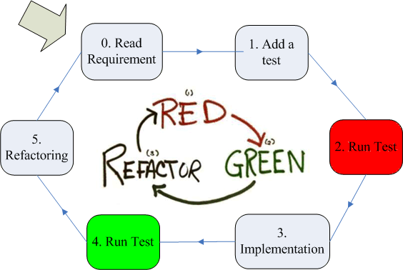
Test-Driven Development

Slide 10
Why test first?
Start with the end in mind (think from point of view of the caller)
This perspective helps for better design
Test coverage is useful byproduct
Greatly reduces the need of debugging

Slide 11
Tests are not the main product in TDD
TDD is a design technique
The design emerges in small steps

Slide 12
How to isolate db tests?
Run tests in one transaction
Makes them repeatable and independent
When that’s not an option - clean up after tests

Slide 13
How to isolate db tests? (2)
Dedicated database
One db per developer
Separate schemas
Shared Dev db may work too
As a rule - avoid running tests on top of production

Slide 14
Other Tips
Make tests self-sufficient
Don't count on the order of tests
Prepare everything you need for the test in its set-up

Slide 15
Ruby-based tools for testing Oracle database code
by Raimonds Simanovskis
Open-source, available at Github and rubygems
ruby-plsql https://github.com/rsim/ruby-plsql
ruby-plsql-spec https://github.com/rsim/ruby-plsql-spec

Slide 16

Overall Architecture
ruby-plsql-spec
RSpec
ruby-plsql
Oracle Server
ruby-oci8 + Oracle Client
or
jdbc driver if using JRuby

Slide 17
Ruby is ...
A dynamic, open source programming language with a focus on simplicity and productivity.
It has an elegant syntax that is natural to read and easy to write.
Ruby in 20 minutes:https://www.ruby-lang.org/en/documentation/quickstart/

Slide 18
Open Source tools by by Raimonds Simanovskis
ruby-plsql https://github.com/rsim/ruby-plsql
ruby-plsql-spec https://github.com/rsim/ruby-plsql-spec

Slide 19
ruby-plsql
Simple Ruby API for calling Oracle PL/SQL procedures:
Connection management
Transaction control
Table operations (insert, select, DML)
PL/SQL procedures/function calling
Object types and collections
Cursors
http://www.oraclethoughts.com/testing/ruby-plsql-cheatsheet/ by Jacek Gębal

Slide 20
ruby-plsql-spec
Init a project structure and helper scripts
Generate code coverage report
Html test output
Examples

Slide 21
You can open several connections
plsql(:default).connect! { :username => 'hr', :password => 'hr', :database => 'xe'} # opens a default connection to database plsql.connect! { :username => 'hr', :password => 'hr', :database => 'xe'} # opens a default connection to database plsql(:another).connect! { :username => 'hr', :password => 'hr', :database => 'xe'} # opens a second connection (referenced by Symbol :another) plsql(:another).logoff # closes connection

Slide 22
RSpec
RSpec is a testing framework that supports Behaviour-Driven Development.
BDD is an approach to software development that combines
Test-Driven Development,
Domain Driven Design,
and Acceptance Test-Driven Planning.
RSpec helps you do the TDD part of that equation, focusing on the documentation and design aspects of TDD.

Slide 23
Getting started - setup
Install Ruby (https://www.ruby-lang.org, rvm, rbenv)
Install Oracle Client
Install Oracle driver
gem install ruby-oci8
or copy JDBC jar to to JRUBY_HOME/lib
gem install ruby-plsql-spec
Create your tests in: spec/..._spec.rb

Slide 24
Execute rspec tests
$ rspec spec/str_spec.rb
String Utils
can split comma-separated list can split empty string can split commas-only strig can split empty and non-empty mix of comma-separated list can split 'alpha,,' can split 'alpha,beta,,'
Finished in 0.02088 seconds (files took 0.30117 seconds to load)
6 examples, 0 failures

Slide 25
Configure database connection settings
# spec/database.yml default: username: test_user1 password: *** database: orcl # host: localhost # port: 1521
# other: # username: scott # password: tiger # database: xe

Slide 26
A simple example
CREATE OR REPLACE FUNCTION betwnstr ( string_in IN VARCHAR2, start_in IN INTEGER, end_in IN INTEGER ) RETURN VARCHAR2 IS l_start PLS_INTEGER := start_in; BEGIN IF l_start = 0 THEN l_start := 1; END IF; RETURN (SUBSTR (string_in, l_start, end_in - l_start + 1)); END;

Slide 27
A simple example
describe "Between string" do it "should be correct in normal case" do plsql.betwnstr('abcdefg', 2, 5).to_eq 'bcde' end it "should be correct with zero start value" do plsql.betwnstr('abcdefg', 0, 5).to_eq 'abcde' end it "should be correct with way big end value" do plsql.betwnstr('abcdefg', 5, 500).to_eq 'efg' end it "should be correct with NULL string" do plsql.betwnstr(nil, 5, 500).to be_nil end end

Slide 28
RSpec - before and after blocks
before(:all)
before(:each)
after(:all)
after(:each)

Slide 29
ruby-plsql-spec sets connections and transaction management in spec_helper
before(:each) - savepoint
after(:each) - rollback
Provides tests isolation

Slide 30
RSpec - let expressions
let(:var) { expression } # lazy evaluated and cached
let!(:var) { expression } # evaluated before each expression
$count = 0 RSpec.describe "let" do let(:count) { $count += 1 } it "memoizes the value" do expect(count).to eq(1) expect(count).to eq(1) end it "is not cached across examples" do expect(count).to eq(2) end end
$count = 0 RSpec.describe "let!" do invocation_order = [] let!(:count) do invocation_order << :let! $count += 1 end it "calls the helper method in a before hook" do invocation_order << :example expect(invocation_order).to eq([:let!, :example]) expect(count).to eq(1) end end

Slide 31
RSpec - describe blocks
describe "Award bonus" do include CustomerFactory [ [1000, 1234.55, 0.10, 1123.46], [nil, 1234.56, 0.10, 123.46], [1000, 1234.54, 0.10, 1123.45] ].each do |salary, sales_amt, commission_pct, result| it "should calculate base salary #{salary.inspect} + sales amount #{sales_amt} * " + "commission percentage #{commission_pct} = salary #{result.inspect}" do employee = create_employee( :commission_pct => commission_pct, :salary => salary ) plsql.award_bonus(employee[:employee_id], sales_amt) expect(get_employee(employee[:employee_id])[:salary]).to eq result end end end
Description
Wraps everything else
Can be nested
Alias “context”

Slide 32
RSpec examples - “it” blocks
it "can split comma-separated list" do expected = ["Alpha", "Beta", "Gamma"] expect(plsql.str.split(cslist)).to eq expected end

Slide 33
Pending examples
RSpec.describe "an example" do it "is implemented but waiting" do pending("something else getting finished") expect(1).to be(1) end end
# Prefix with “x” to skip
RSpec.describe "an example" do xit "is skipped using xit" do end xspecify "is skipped using xspecify" do end xexample "is skipped using xexample" do end end

Slide 34
RSpec expectations and matchers
expect(result).to eq(3) expect(list).not_to be_empty pi.should be > 3
expect { ... }.to raise_error expect { ... }.to raise_error(ErrorClass) expect { ... }.to raise_error("message")
expect([1, 2, 3]).to include(1) expect([1, 2, 3]).to include(1, 2) expect(:a => 'b').to include(:a => 'b') expect("this string").to include("is str") expect([1, 2, 3]).to contain_exactly(2, 1, 3) expect([1, 2, 3]).to match_array([3, 2, 1])

Slide 35
Testing exceptions
it "should raise ORA-06510 exception if commission percentage is missing" do salary, sales_amt, commission_pct = 1000, 1234.55, nil employee = create_employee( :commission_pct => commission_pct, :salary => salary ) expect { plsql.award_bonus(employee[:employee_id], sales_amt) }.to raise_error(/ORA-06510/) end

Slide 36
Factory pattern
module EmployeeFactory def create_employee(params) employee = { :employee_id => plsql.employees2_seq.nextval, :last_name => 'Last', :email => 'last@example.com', :hire_date => Date.today, :job_id => plsql.jobs.first[:job_id], :commission_pct => nil, :salary => nil }.merge(params) plsql.employees2.insert employee get_employee employee[:employee_id] end # Select employee by given key def get_employee(employee_id) plsql.employees2.first :employee_id => employee_id end end

Slide 37
Object type returned via ref cursor
create or replace type t_employee force as object ( employee_id number(15), first_name varchar2(50), last_name varchar(50), hire_date date);
procedure get_employee(op_cursor out sys_refcursor, emp_id in number);
plsql.api_employee.get_employee( :emp_id => employee[:employee_id]) do |result| expect(result[:op_cursor].fetch_hash[:complex_type][:last_name]).to eq 'John' end

Slide 38
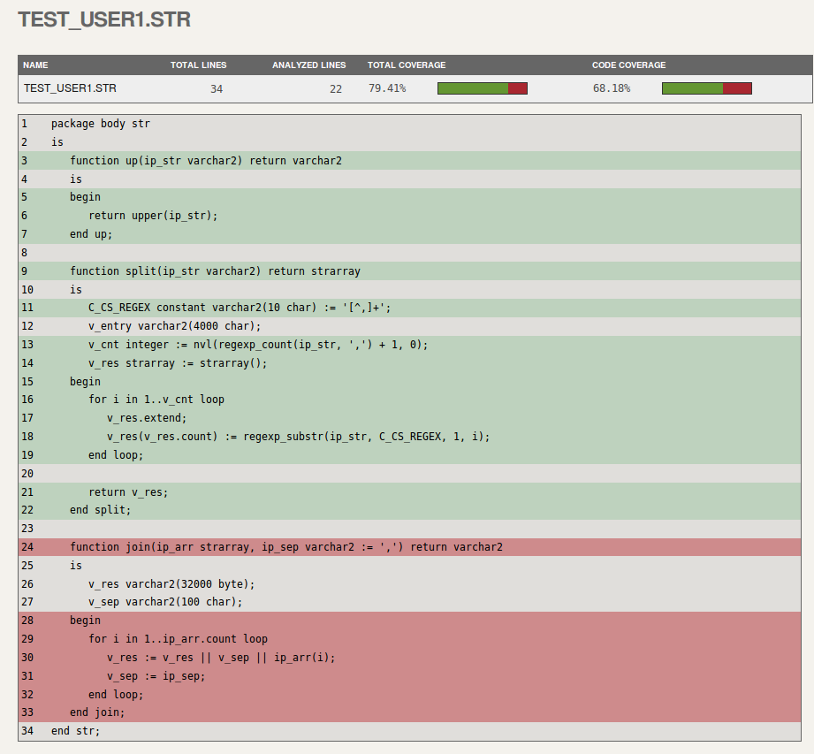
Coverage reporting: plsql-spec run --coverage

Slide 39
TDD Kata - Roman Numerals in Oracle
An exercise to get started with TDD using Oracle and RSpec
Task: convert normal (arabic) to roman numerals
Set your goals:
to learn the tools
to exercise TDD cycle; build habit
Perform the tasks using TDD principles (Red, Green, Refactor)
Commit after step to document it
Reflect on how you feel about it
what is easy and what hard
what you like and don’t like
http://www.oraclethoughts.com/testing/test-drive-your-oracle-database-yes-its-doable-and-its-fun/

Slide 40
Pros (of using ruby-plsql for testing Oracle code)
Doesn’t “pollute” the DB with additional objects
Supports multiple concurrent connections
Good isolation of individual tests
Powerful and readable syntax (once you get used to it)
PL/SQL calls syntax is almost the same as using native PL/SQL
Integrates with mature testing framework (RSpec)
Open Source tools - you can extend, fix issues, study how it works internally
http://www.oraclethoughts.com/wp-content/uploads/2015/08/jgebal_utplsql-vs-ruby-plsql-feature-comparison1.pdf

Slide 41
Resources
https://github.com/javornikolov/bgoug-rubyplsql-spec - a demo project with some examples
https://github.com/rsim/ruby-plsql-spec - ruby-plsql-spec GitHub project
https://github.com/rsim/ruby-plsql - ruby-plsql GitHub project
https://relishapp.com/rspec/ - RSpec documentation
http://betterspecs.org/ - RSpec guidelines
http://www.oraclethoughts.com/testing/ - blog of JacekGębal
http://www.oraclethoughts.com/testing/ruby-plsql-cheatsheet/ - ruby-plsql Cheat Sheet
http://www.oraclethoughts.com/wp-content/uploads/2015/08/jgebal_utplsql-vs-ruby-plsql-feature-comparison1.pdf - comparison with utlplsql
http://blog.rayapps.com/2009/11/27/oracle-plsql-unit-testing-with-ruby - blog post by presentation by Raimonds Simanovskis
http://www.slideshare.net/rsim/plsql-unit-testing-with-ruby - presentation by Raimonds Simanovskis

Slide 42
Thank You!
Q&A
nikolov dot javor at gmail

Slide 43
Question 1 - can we use “sqlldr”
Yes - external process may be spawned from Ruby. Example: `sqlldr user=#{user}/#{pass} control=#{file_name} …`
However:
The external process will commit the changes
You’ll need to clean it up (e.g. in an :after hook)

Slide 44
An alternative - load external files using Ruby
Will provide better isolation
DML is in the same transaction, no need to commit. The default rollback will do the cleanup
Less side effects (not other sessions will see this test data /as it’s not committed/)
Example - loading from CSV require ‘csv’ # A standard built-in library # Parse into an array, skip 1st line, map to a hash (1st column to :id, 2nd - to :name) data = CSV.read("/tmp/f.csv").drop(1).map { |values| {:id => values[0].to_i, :name => values[1]} } # Insert into emps(id, name) plsql.emps.insert data

Slide 45
Question 2 - checking the data after a database call
Examine the ruby-plsql Cheet Sheet about how to query the database
If it better suites your needs - you may alternatively consider DbFit
Wiki-based tabular syntax (more compelling for non-technical people)
Tests and their output may look visually better for larger sets of data
Less control in the wiki definitions
Finer control is still possible with custom fixtures (Java-based)
But it’s more complicated than the Ruby-based stack presented here
https://github.com/javornikolov/tdd-with-dbfit-bgoug-2013057

